Slide 1
Climate and Soils

Slide 2
Climate

Slide 3
Climate = long term average weather
A = tropical
B = arid
C = temperate
D = cold
E = polar

Slide 4
How would you describe Lubbock’s climate?

Slide 5
Climate = long term average weather
Bsk = cold,
semi-arid

Slide 6
Why do we care about climate?

Slide 7
Earth’s Energy Budget

Slide 8
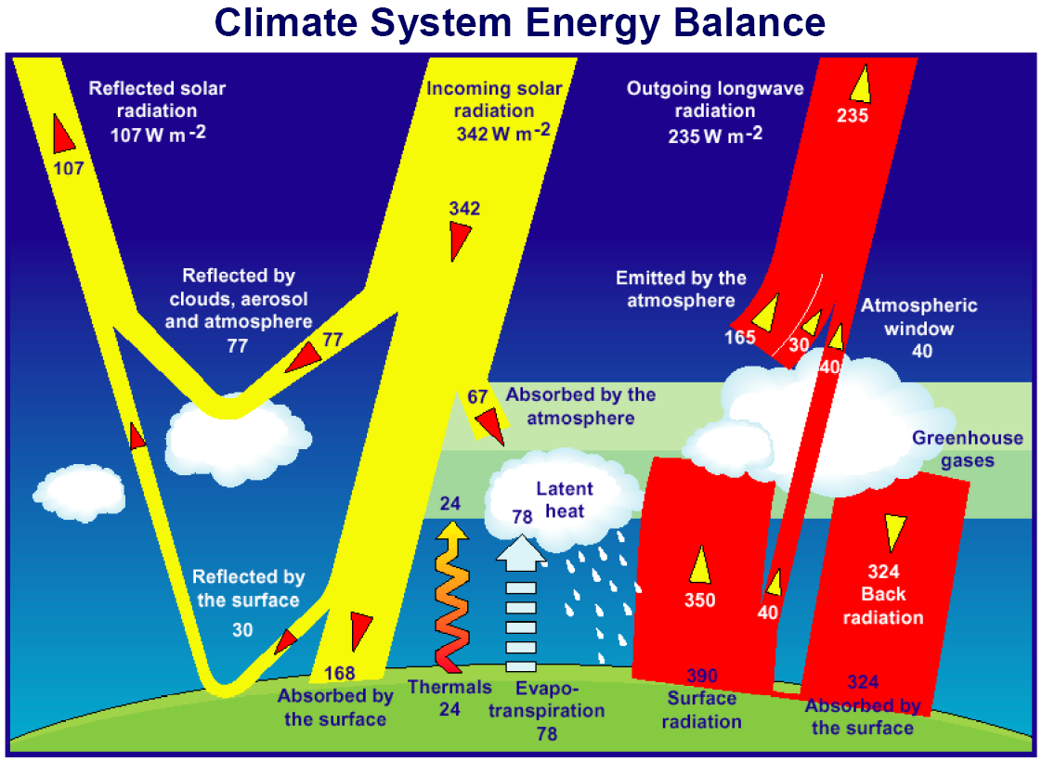

Slide 9
The planetary boundary layer:
where the turbulent fluxes happen!

Slide 11
Aerosols
Atmospheric particles
Reflect incoming radiation back to space
What’s the climate impact?

Slide 12
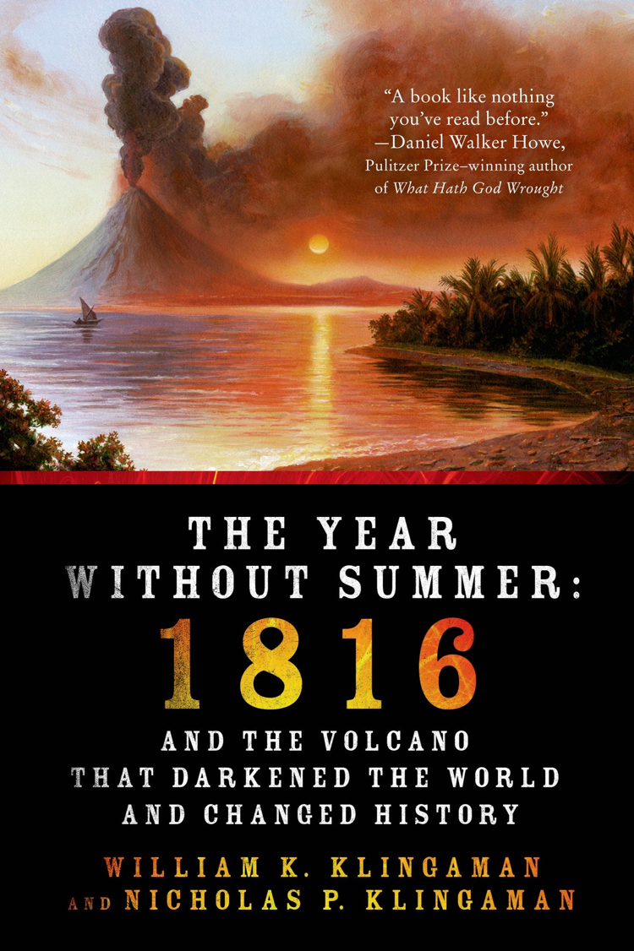
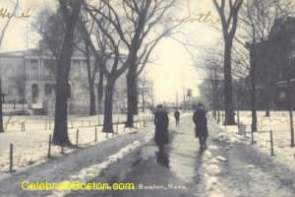
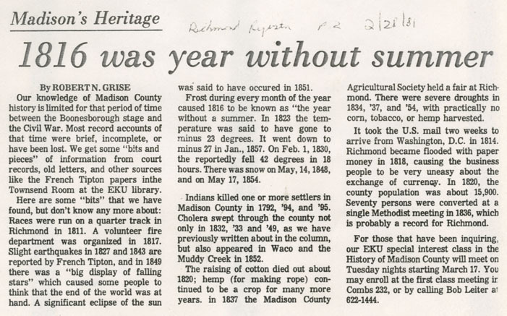
June 6th, 1816
Mount Tambora erupts (April 5th, 1815)

Slide 13
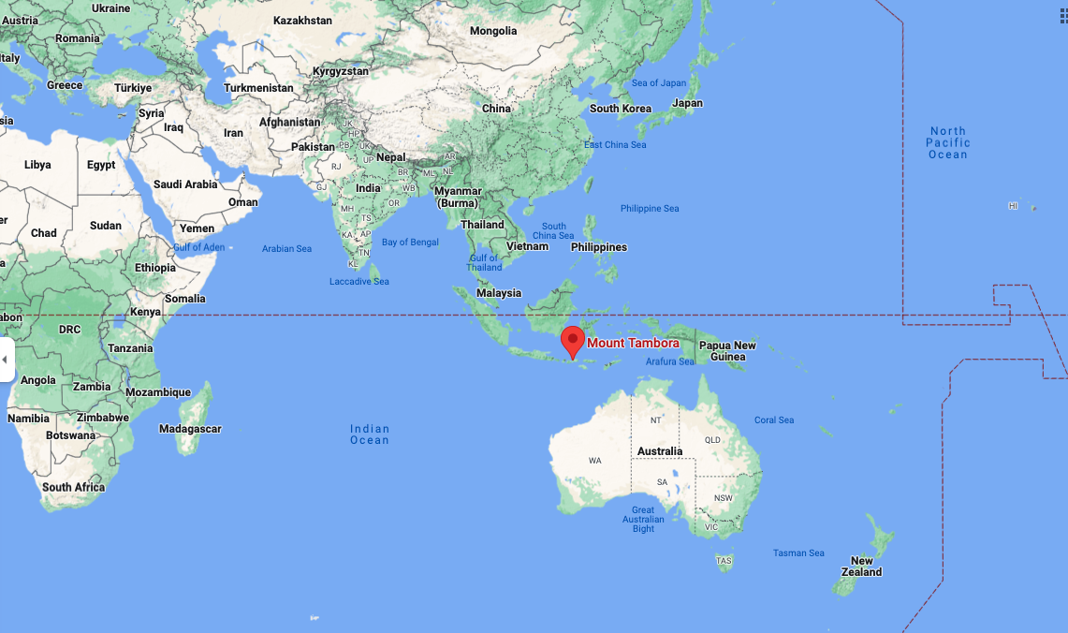

Slide 16
Albedo
Radiation reflected by a surface
High degree of variability in albedo of Earth’s surface

Slide 17
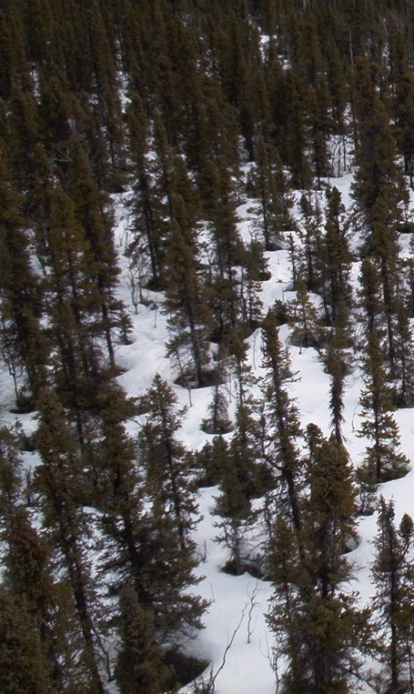
Albedo Examples
Oceans/lakes 0.03-0.10
Sea ice 0.30-0.45
Fresh snow 0.75-0.95
Tundra 0.15-0.20
Conifer forest 0.09-0.15
Broadleaf forest 0.15-0.20
Desert 0.20-0.45
Soil (wet) 0.05
Soil (dry) 0.40

Slide 18
Albedo Examples
Oceans/lakes 0.03-0.10
Sea ice 0.30-0.45
Fresh snow 0.75-0.95
Tundra 0.15-0.20
Conifer forest 0.09-0.15
Broadleaf forest 0.15-0.20
Desert 0.20-0.45
Soil (wet) 0.05
Soil (dry) 0.40
Can you rank these?

Slide 19
Amount reflected
Oceans/lakes 0.03-0.10
Sea ice 0.30-0.45
Fresh snow 0.75-0.95
Tundra 0.15-0.20
Conifer forest 0.09-0.15
Broadleaf forest 0.15-0.20
Desert 0.20-0.45
Soil (wet) 0.05
Soil (dry) 0.40

Slide 21
Greenhouse gases
Trap outgoing longwave radiation
Act like a blanket over the Earth’s surface
Keep us warm!

Slide 22
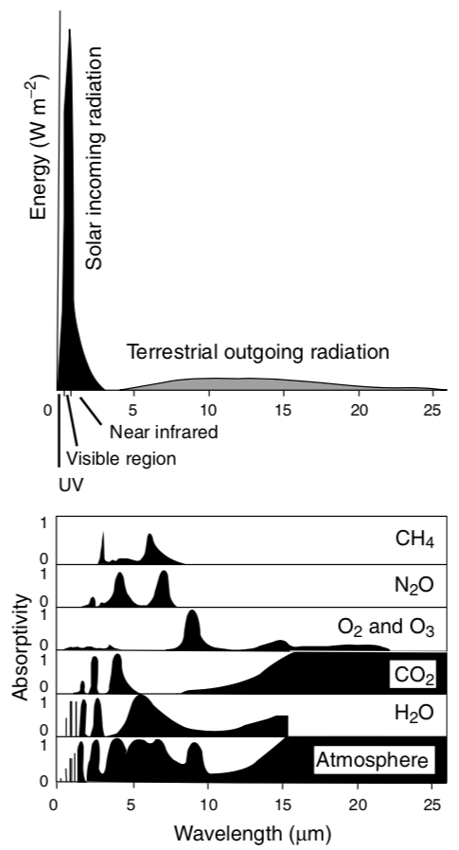
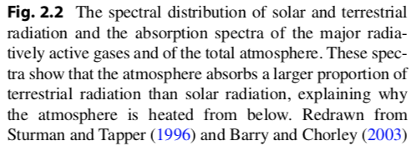

Slide 23
NOAA

Slide 24
Things that impact climate: Topography

Slide 25
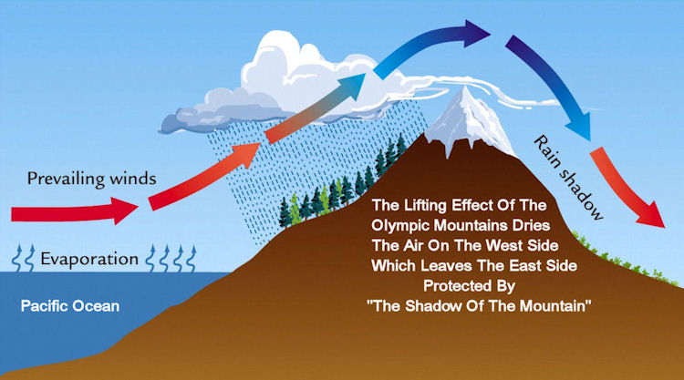
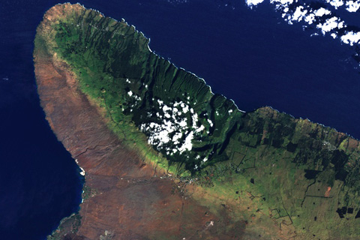
Rain Shadows
Big Island in Hawaii

Slide 26
Things that impact climate: Vegetation

Slide 27
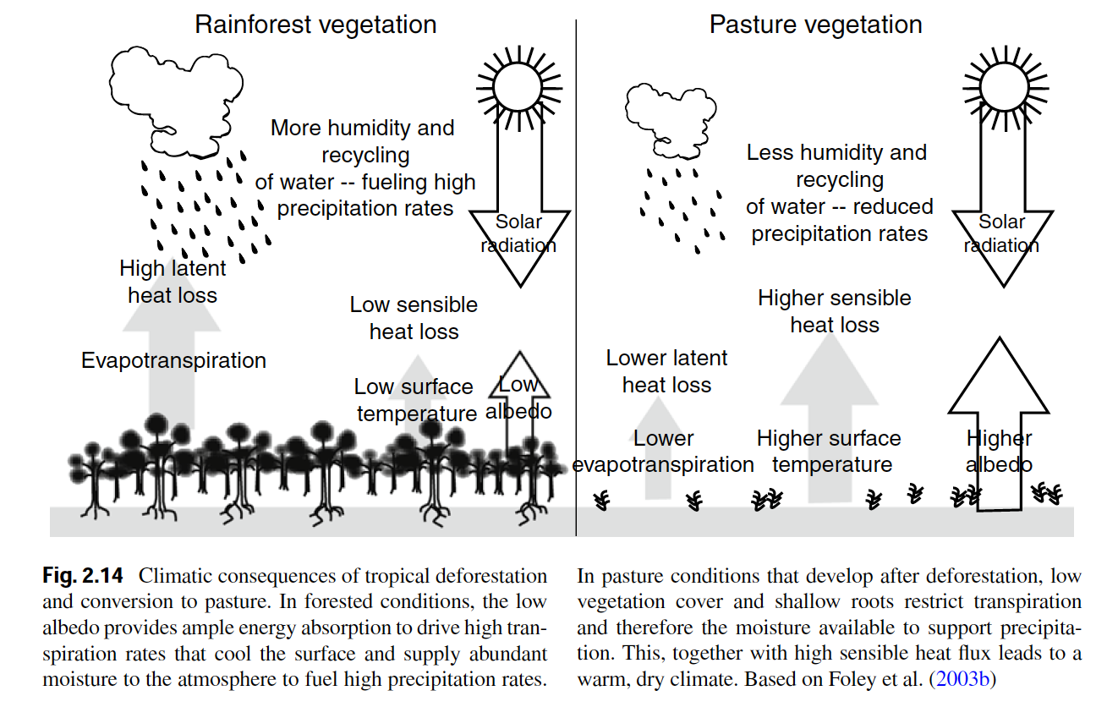
Vegetation itself can change climates

Slide 28
Long-term climate

Slide 29
Without humans would climate change over time?

Slide 30
Without life on Earth would climate change over time?

Slide 31
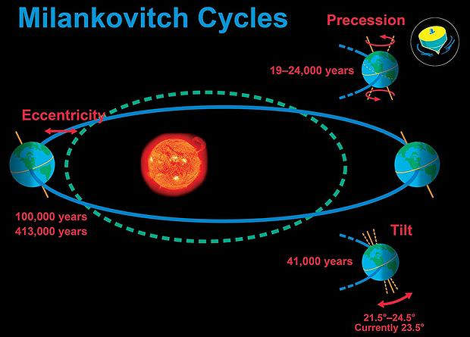

Slide 34
Soils

Slide 35
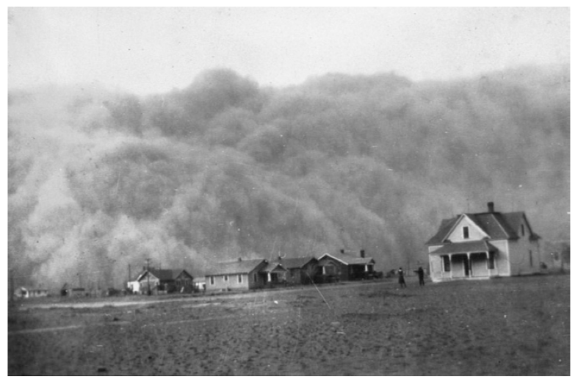
Soil Erosion and Formation

Slide 36
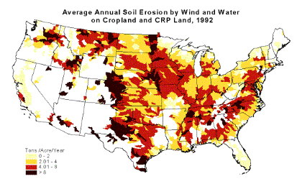
Soil Erosion

Slide 37
Erosion
Transfers carbon, nutrients and sediment from terrestrial to aquatic ecosystems
Often occurs faster than soils can be rebuilt
Leads to loss of fertility of agricultural soils

Slide 38
Erosion
Transfers carbon, nutrients and sediment from terrestrial to aquatic ecosystems
Often occurs faster than soils can be rebuilt
Leads to loss of fertility of agricultural soils

Slide 39
Formation: State factors
Parent material
Climate
Organisms
Topography/Relief
Time

Slide 40
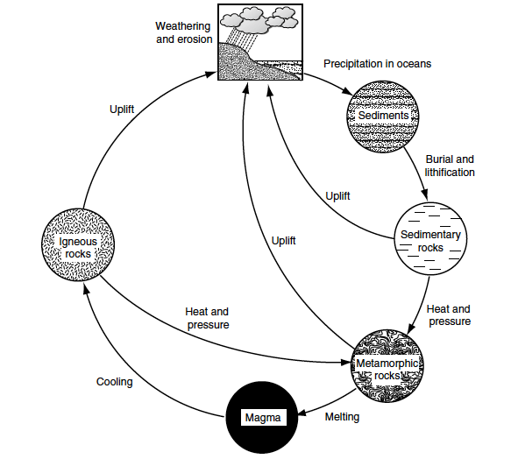
Parent Material
Physical and chemical properties of rocks
Uplift and weathering occur at different rates
100-200my

Slide 41
Climate
Temperature, moisture, CO₂, O₂
Determine weathering and soil formation

Slide 42
Organisms
Influence soil chemical and physical properties
Input litter quantity/quality
Uptake of mineral nutrients and input of organic nutrients

Slide 43
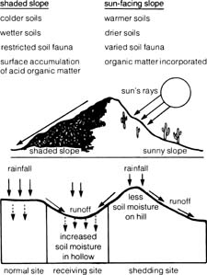
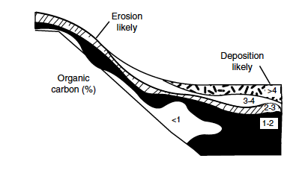
Topography
Influences climate, moisture availability, and particle transport

Slide 44
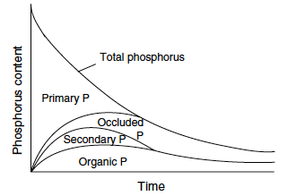
Time
Rocks weather slowly – minerals become occluded

Slide 45
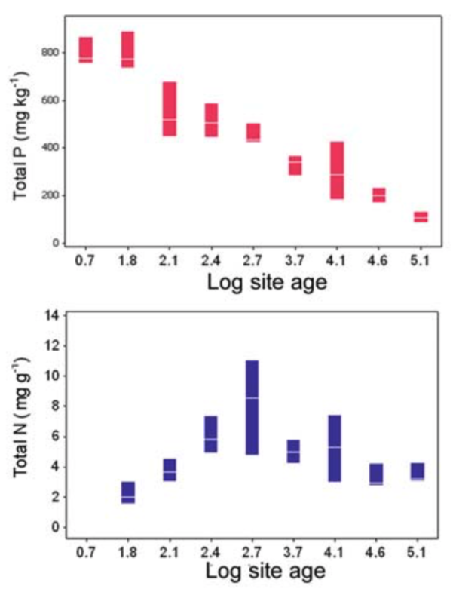
What could explain these trends?

Slide 46
Soil properties

Slide 47
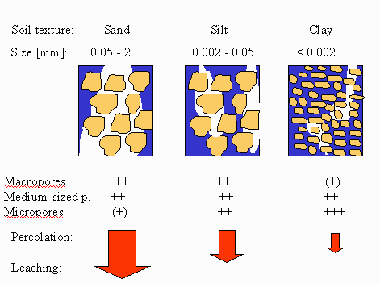
Soil Texture

Slide 48
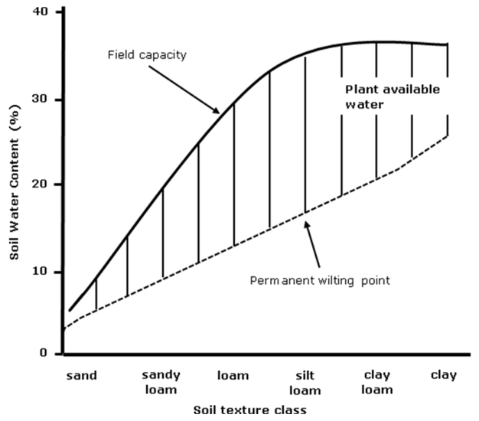
Physical: Soil texture
Sand: 0.05 – 2.0 mm
Silt: 0.002 – 0.05 mm
Clay: < 0.002 mm

Slide 49
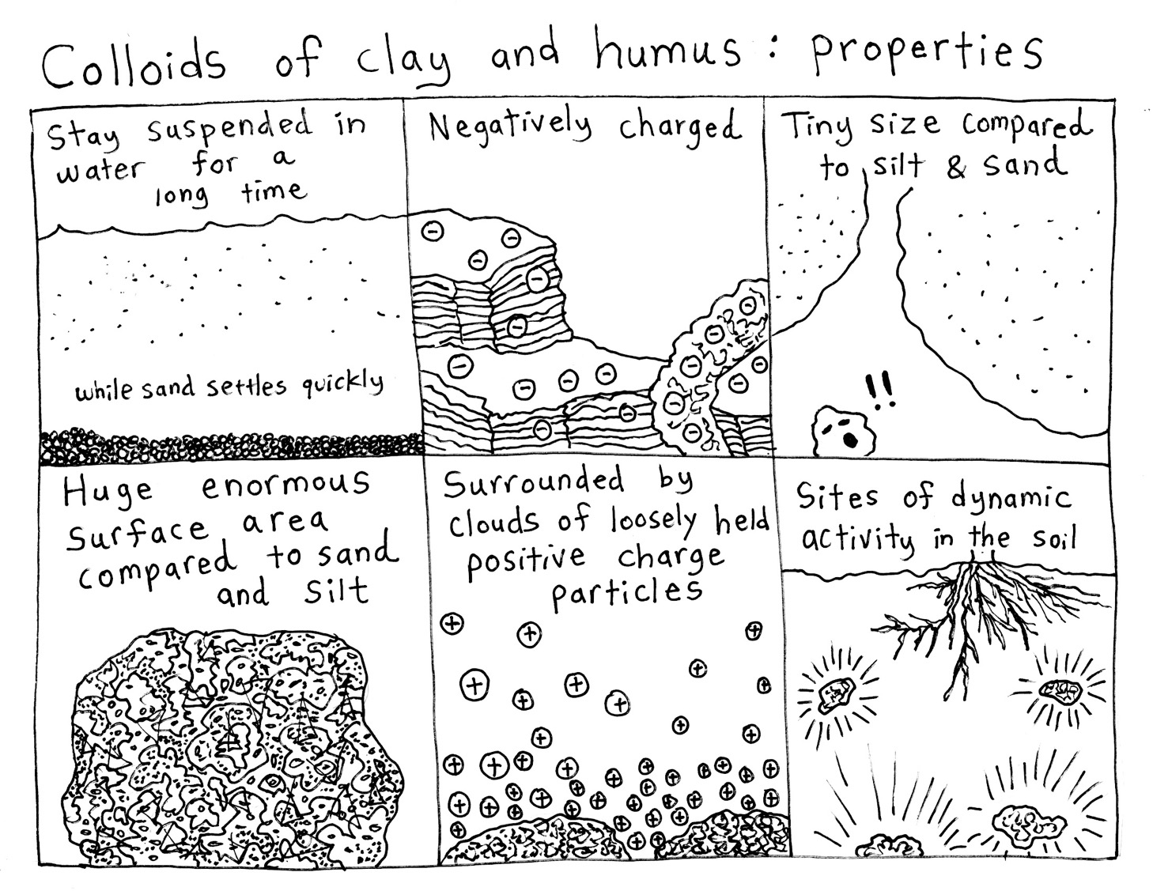

Slide 50
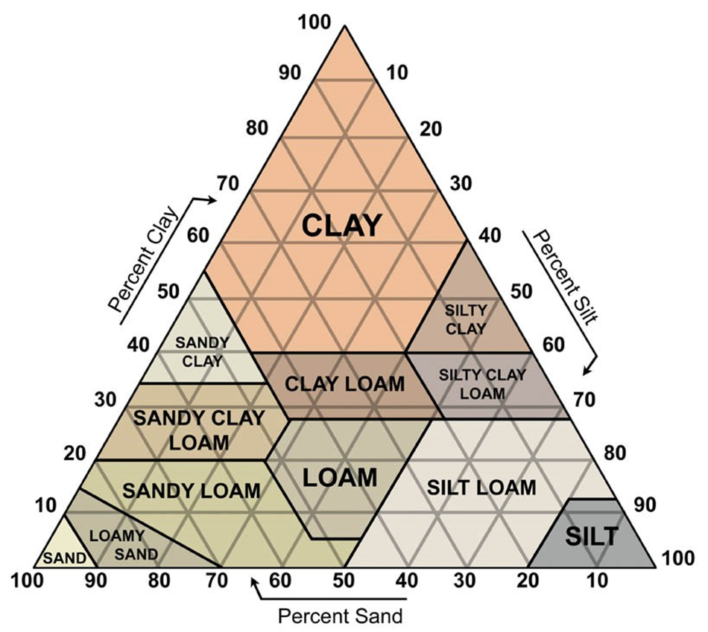
Physical: Soil texture

Slide 51
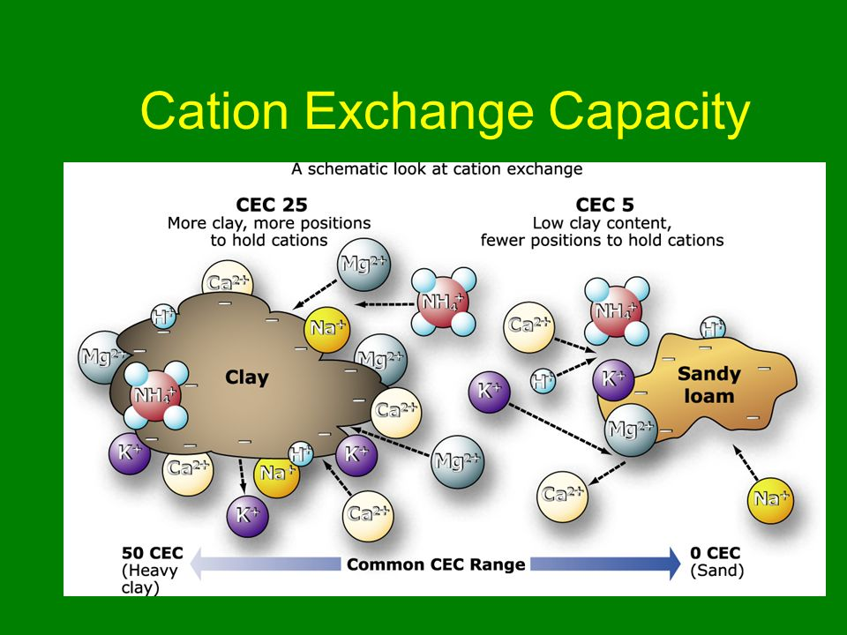

Slide 52
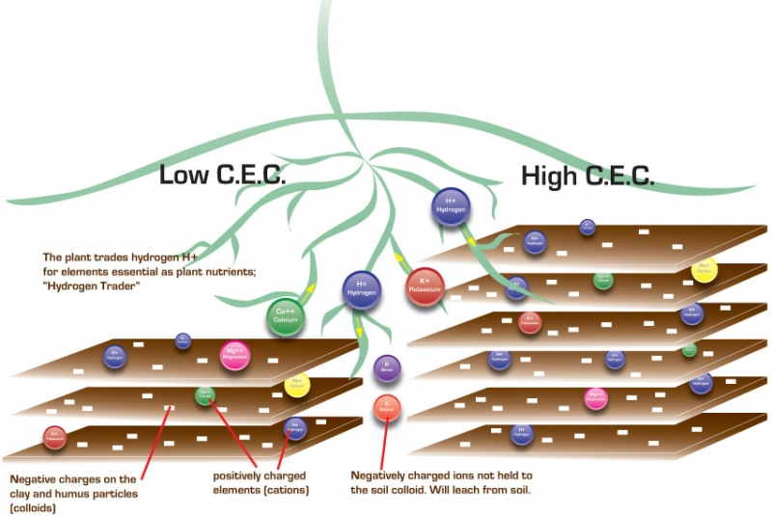

Slide 53
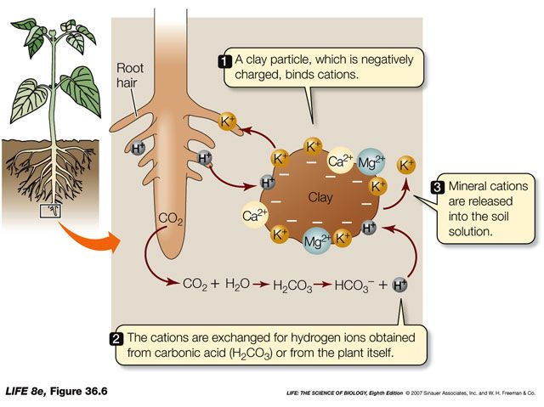
Chemical: Cation Exchange Capacity

Slide 54
Biomes

Slide 55
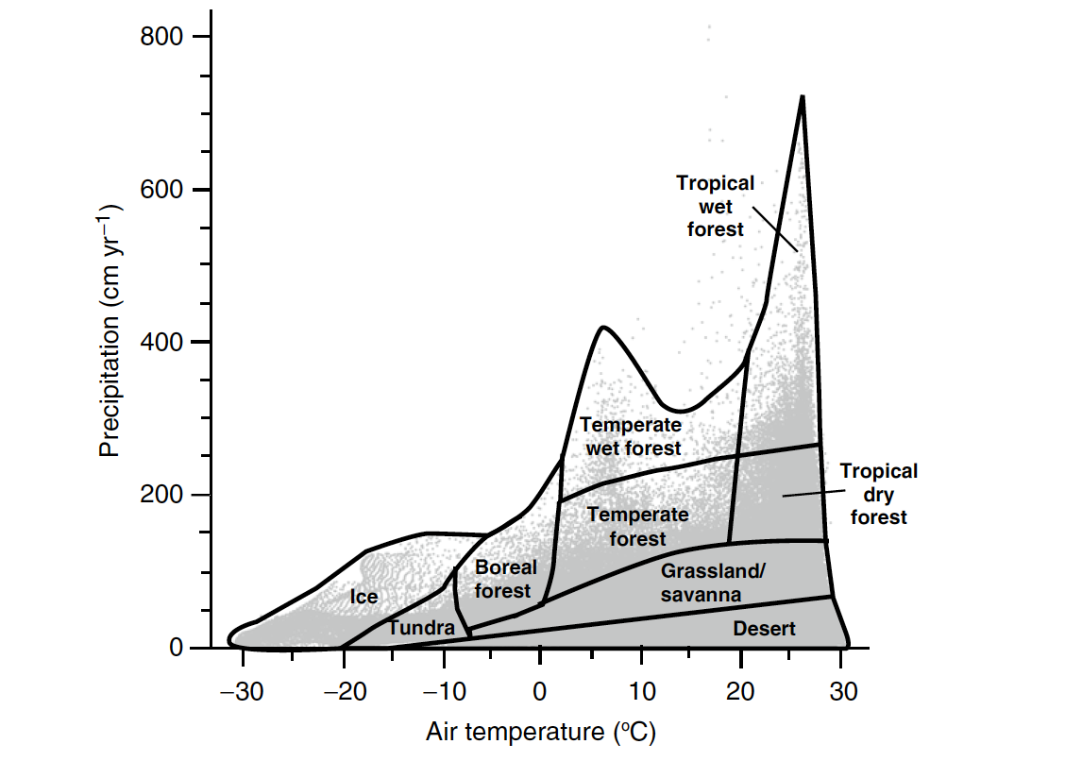
Climate determines biome distributions
Whittaker diagram

Slide 56
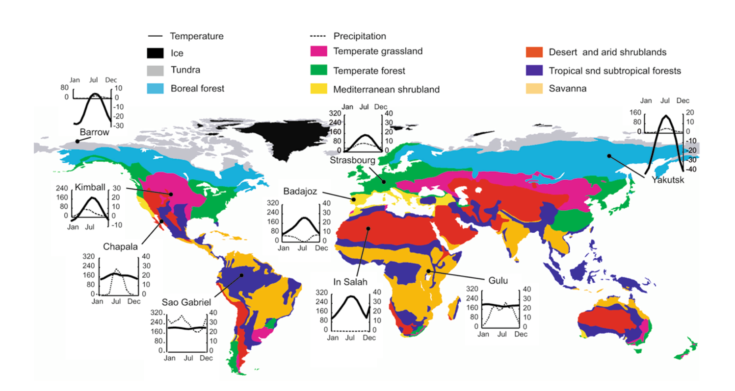
Biome distributions on Earth

Slide 57
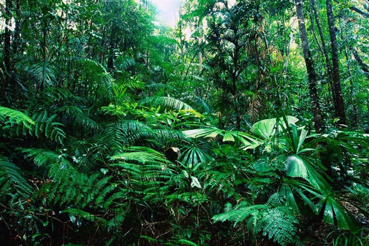
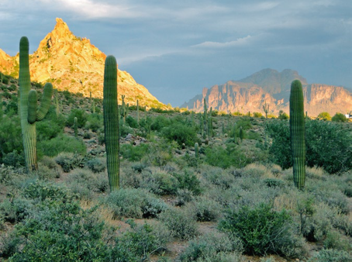
Characteristics of Biomes
Tropical Rainforest
Species diverse
Nutrient poor
Consistent climate
Desert
Bare soil
Calcium carbonate soils (basic)
Inconsistent climate

Slide 58
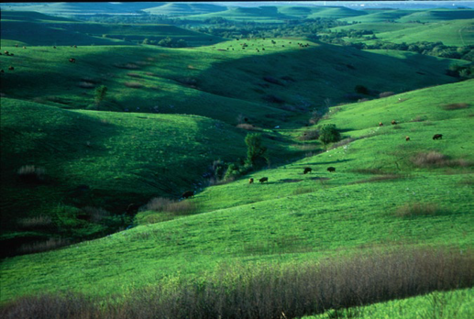
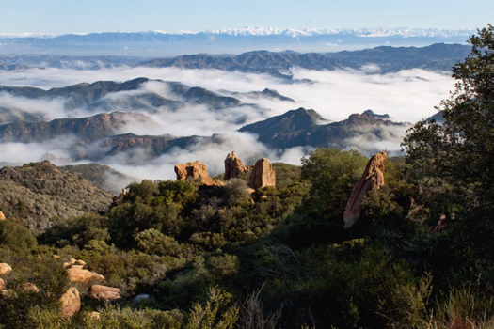
Temperate Grasslands
Clay soils
Deep soil carbon layer
Fire prone
Mediterranean shrublands
One of the most endangered habitats
Many endemic species
Only in coastal areas

Slide 59
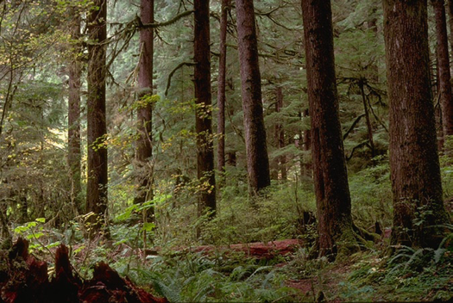
Temperate forests
Relatively species rich
Can have deciduous and non-deciduous trees
Taiga (Boreal forests)
Species poor
NPP in growing season can be as large as tropical forests
Experiencing warming at faster rates

Slide 60
What is our biome?

Slide 61
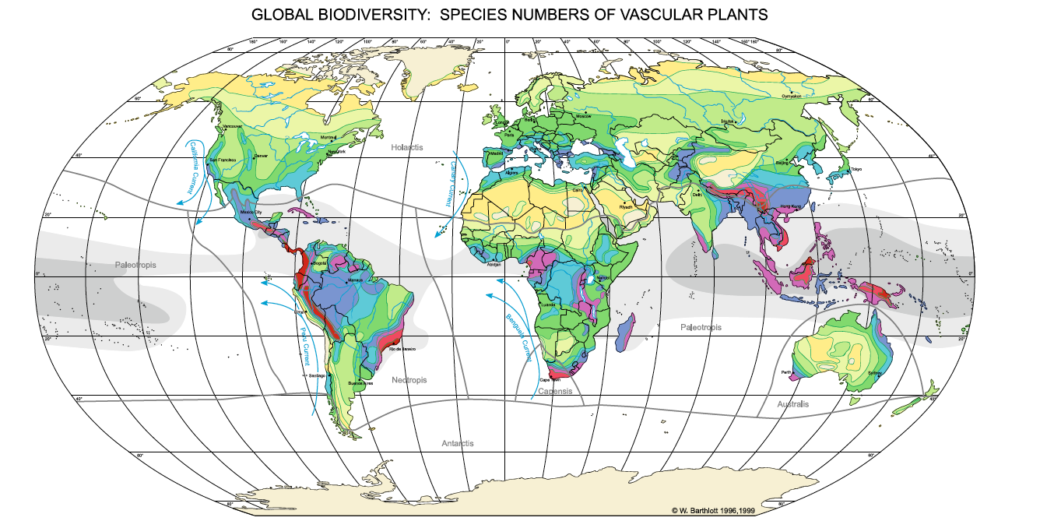
Latitudinal diversity gradient
Applies to plants and animals, but not necessarily microbes

Slide 62
Latitudinal diversity gradient
WHY?????
Applies to plants and animals, but not necessarily microbes

